Slide 1
Pneumonia Detection

Slide 2
Background
The risk of pneumonia is immense for many, especially in developing nations where people rely on polluting forms of energy.
The problem can be further aggravated due to the dearth of medical resources and personnel.
One of the most urgent needs in combatting pneumonia is a cost-effective way of X-ray photos diagnosing.

Slide 3
Abstract
This project proposes a machine learning model using convolutional neural network to classify and detect the presence of pneumonia from a collection of chest X-ray image samples.
This model could help mitigate the reliability and interpretability challenges often faced when dealing with medical imagery.
It is difficult to obtain a large amount of pneumonia dataset for this classification task.
Therefore, we deployed Structure Correcting Adversarial Network to segment lung fields relied on a pre-trained model to improve the validation and classification accuracy of the CNN model and achieved remarkable validation accuracy.

Slide 4
GANs-SCAN
In medical field, always lacking labeled training data. In this context, generative modeling can still perform well. The adversarial training concept behind GANs theoretically eliminates the need to model explicit pixelwise objective functions by learning a rich similarity metric to tell real and fake data apart. This allows to optimize for concepts in images beyond the pixel-level, leading to more realistic results.
Dai[1] et al. propose a GAN based solution (SCAN) to enhance global consistency of segmentation and extract contours of the heart and left/right lungs. It is a fully connected network with a VGG down-sampling path and residual blocks to use much fewer feature maps in the generator. And we use this is our preprocessing step.

Slide 5
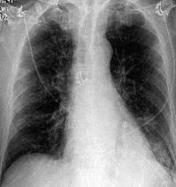
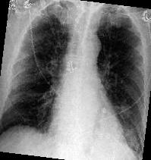
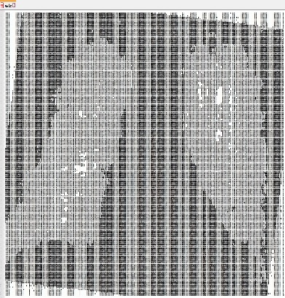
Preprocess
Data Augmentation
Due to lack of data
Increase sample size
We can expand our dataset three times by rotation.
Graph process
Decrease unnecessary factors on graphs
Increase emphasis on lung

Slide 6
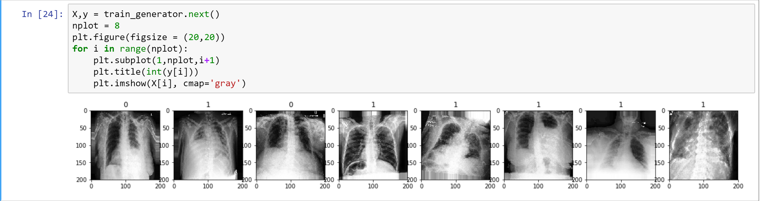
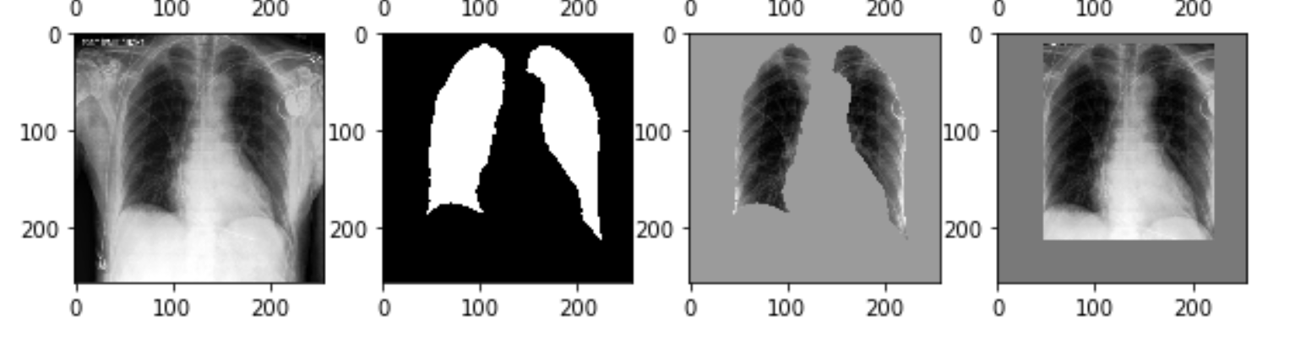
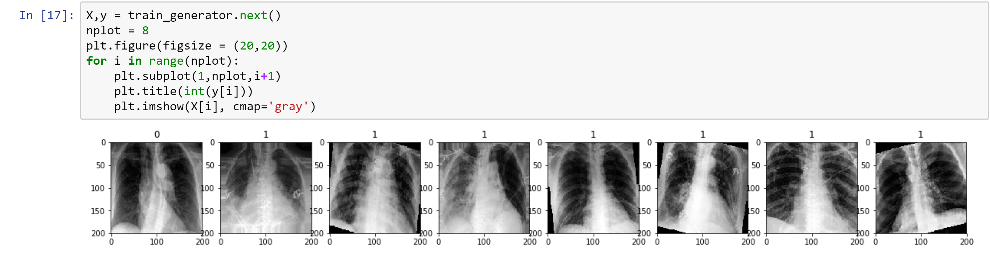
Construction
Preprocessed data
Original Data
Pretrained model
Segmentation
Augmentation
More layers
Test accuracy with model
Data processed

Slide 7
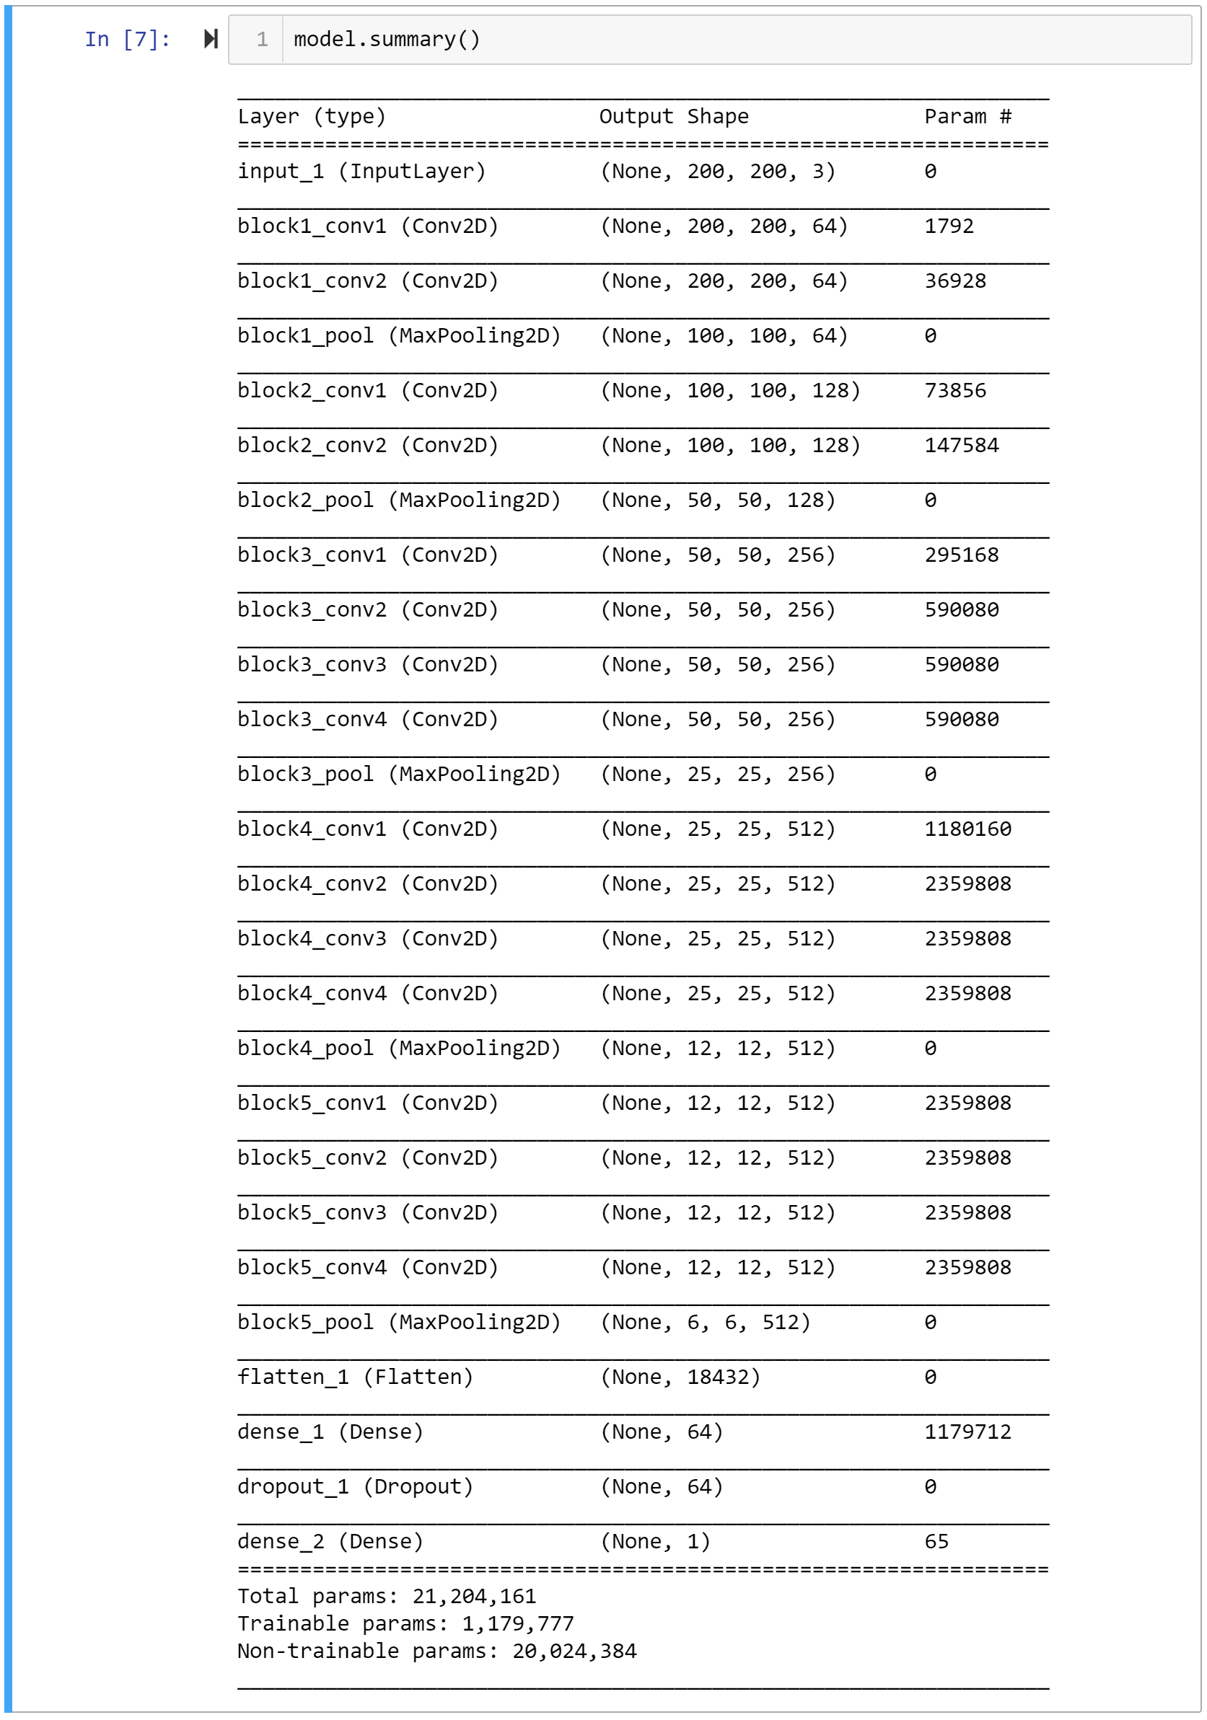
Construction
Preprocessed data
Model | T-1 ACC | T-5 ACC | Depth
VGG16 | 0.715 | 0.901 | 23
VGG19 | 0.727 | 0.910 | 26
Pretrained model
Compared with VGG16:
Higher accuracy
More depth and parameters
More layers
Test accuracy with model

Slide 8
Construction
Preprocessed data
Input layer:
We put input layer of VGG to 200*200*3 to fit our X-ray images
Dense layer:
We use activation function ‘relu’ rather than ‘sigmoid’ to avoid gradient vanishing
Dropout layer:
In this case we drop 90% percent of coefficients to avoid overfitting.
Pretrained model
More layers
Test accuracy with model

Slide 9
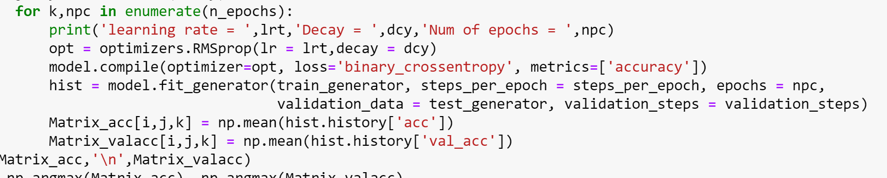
Construction
Preprocessed data
Totally, after data augmentation, We get
50031 images for training
12516 images for testing.
Both in two classes
For parameter optimization, we can build a GridSearch function to get the best set of parameter in this problem.
We set three learning rates, three decays and three number of epochs for the grid searching.
Pretrained model
More layers
Test accuracy with model

Slide 10
Parameters
Epoch=5 |  | Learning rate
 |  | 1e-3 | 1e-4 | 1e-5
Decay | 1e-3 | 77.71% | 77.91% | 77.73%
 | 1e-4 | 77.78% | 79.03% | 78.19%
 | 1e-5 | 75.63% | 77.78% | 78.68%
Epoch=10 |  | Learning rate
 |  | 1e-3 | 1e-4 | 1e-5
Decay | 1e-3 | 77.37% | 77.17% | 77.43%
 | 1e-4 | 77.51% | 76.08% | 76.73%
 | 1e-5 | 78.71% | 78.36% | 76.36%
Epoch=15 |  | Learning rate
 |  | 1e-3 | 1e-4 | 1e-5
Decay | 1e-3 | 77.86% | 77.45% | 77.26%
 | 1e-4 | 78.08% | 77.50% | 77.81%
 | 1e-5 | 77.17% | 77.28% | 77.45%

Slide 11
Evaluation
After grid searching, we get the optimal parameter with the highest accuracy.
Learning rate = 0.0001, decay = 0.0001 and Epochs = 5
Then we use F1-score to evaluate this model.
With an average F1-score of 0.8729, our model exceeds average radiologist performance on the F1 metric.

Slide 12
Evaluation
After grid searching, we get the optimal parameter with the highest accuracy.
Learning rate = 0.0001, decay = 0.0001 and Epochs = 5
Then we use F1-score to evaluate this model.
With an average F1-score of 0.8729, our model exceeds average radiologist performance on the F1 metric.

Slide 13
Crosswalk detection

Slide 14
This project is about zebra-crossing detection, which is aim to help people with vision disability to avoid risk and stay safety.
The main purpose is to find the region of zebra-crossing in the street photo.
We deployed an image semantic segmentation model for crosswalk locating, the result we got is a pixel-wise map of crosswalk, then we can use Hough Transfer or other computer vision method to detect the other information of zebra-crossing.

Slide 15
Unet model is especially designed to effectively solve binary image segmentation problems and is commonly used in segmentation task like satellite and medical images.
The deep learning network we used consist of two parts called contract unit contains a down-sampling sequence and expand unit as up-sampling sequence.
In this problem, we designed a Unet model with input size as 800*800*3 to avoid losing too much information.

Slide 16
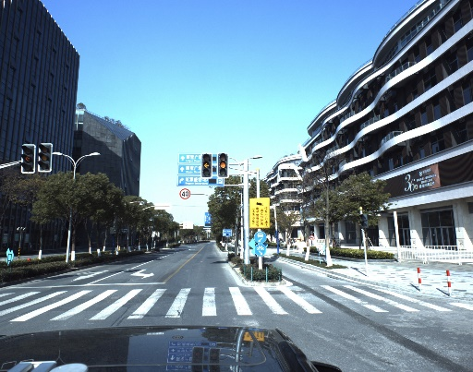
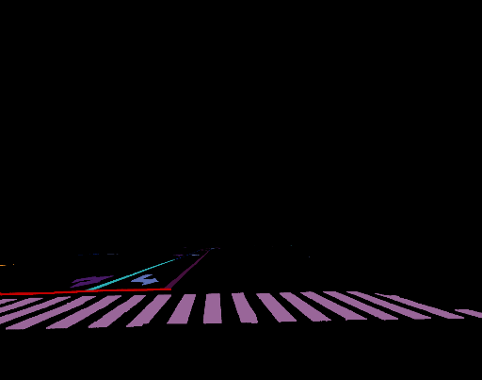
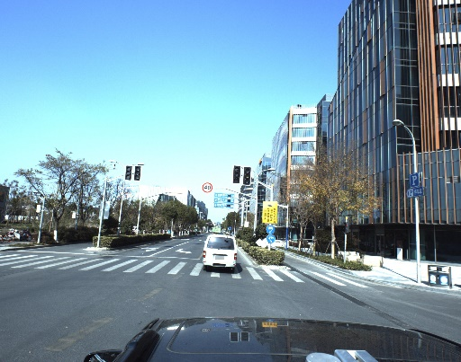
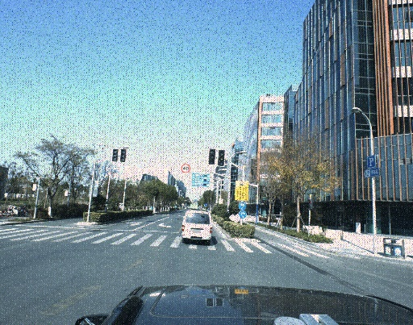
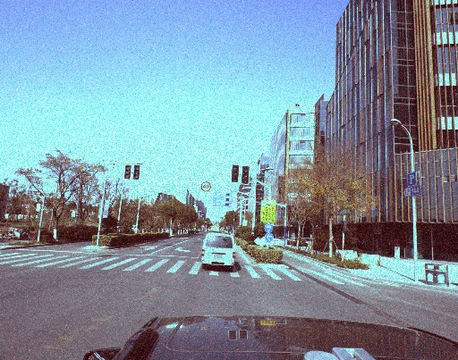
We use the labeled data from Baidu Apollo Scape dataset and did data augmentation by adding slat pepper noise and flipping.

Slide 17
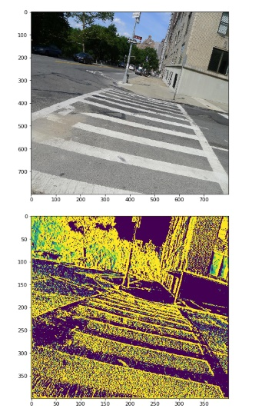
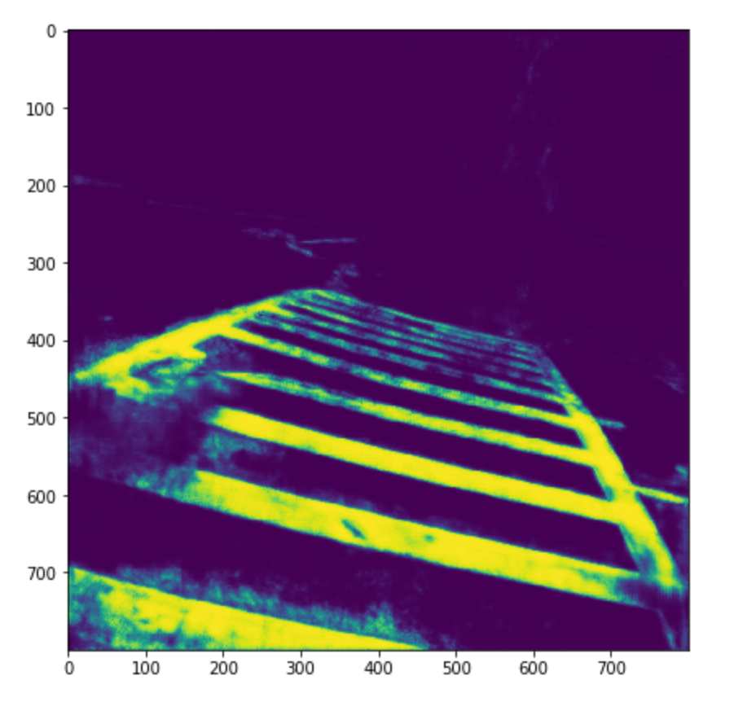
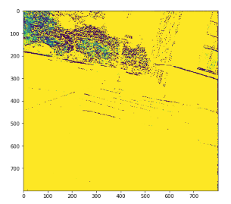
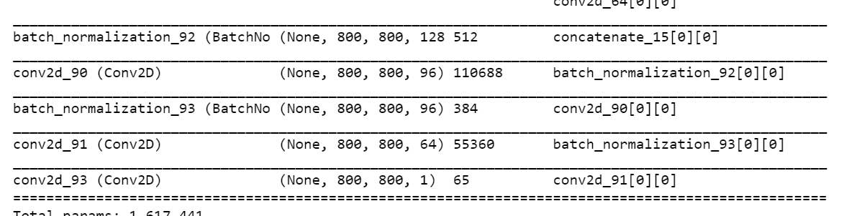
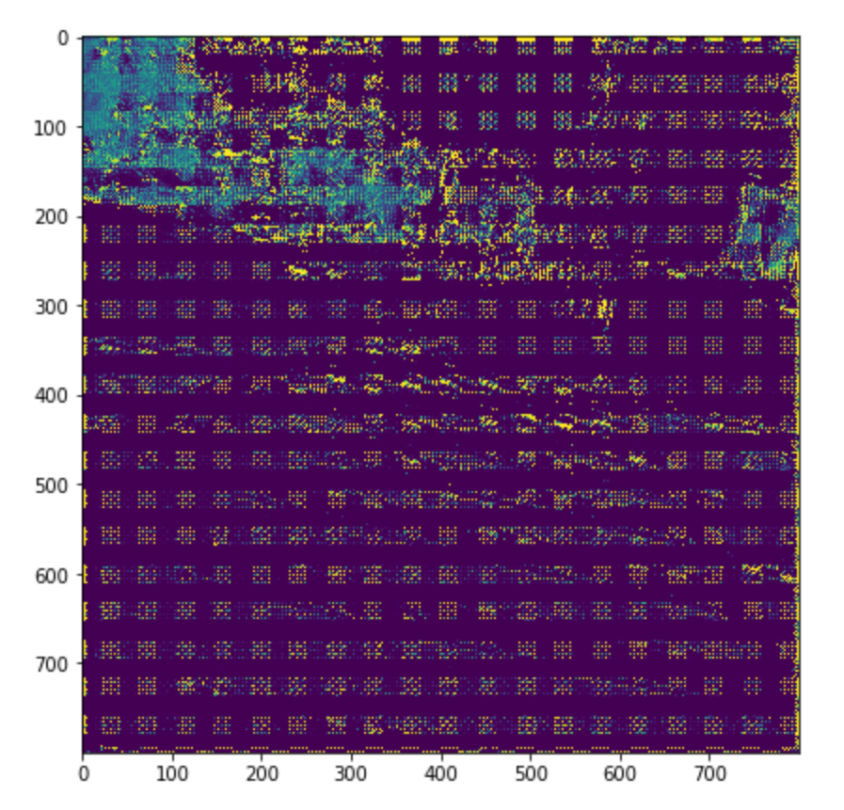
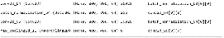
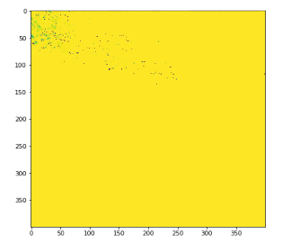
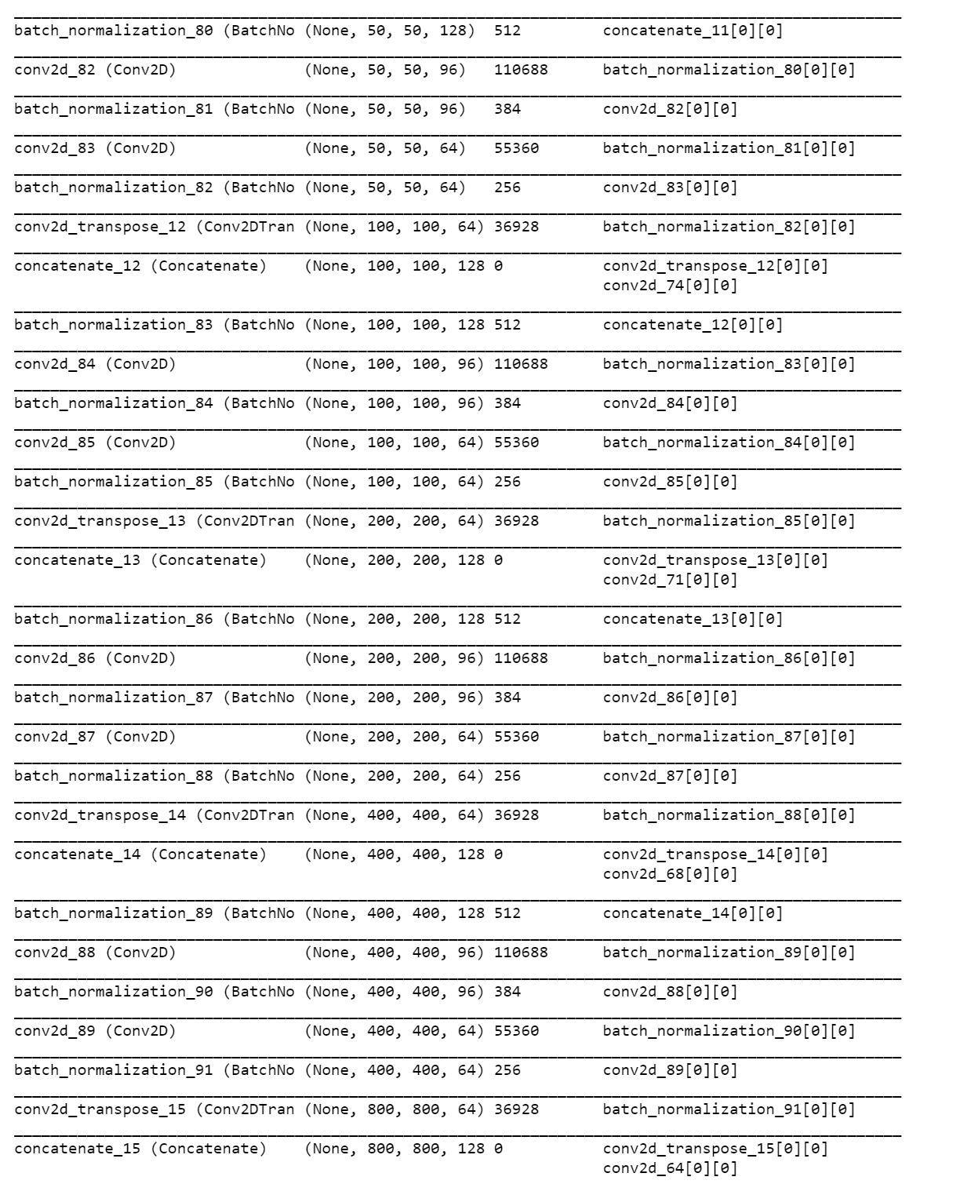
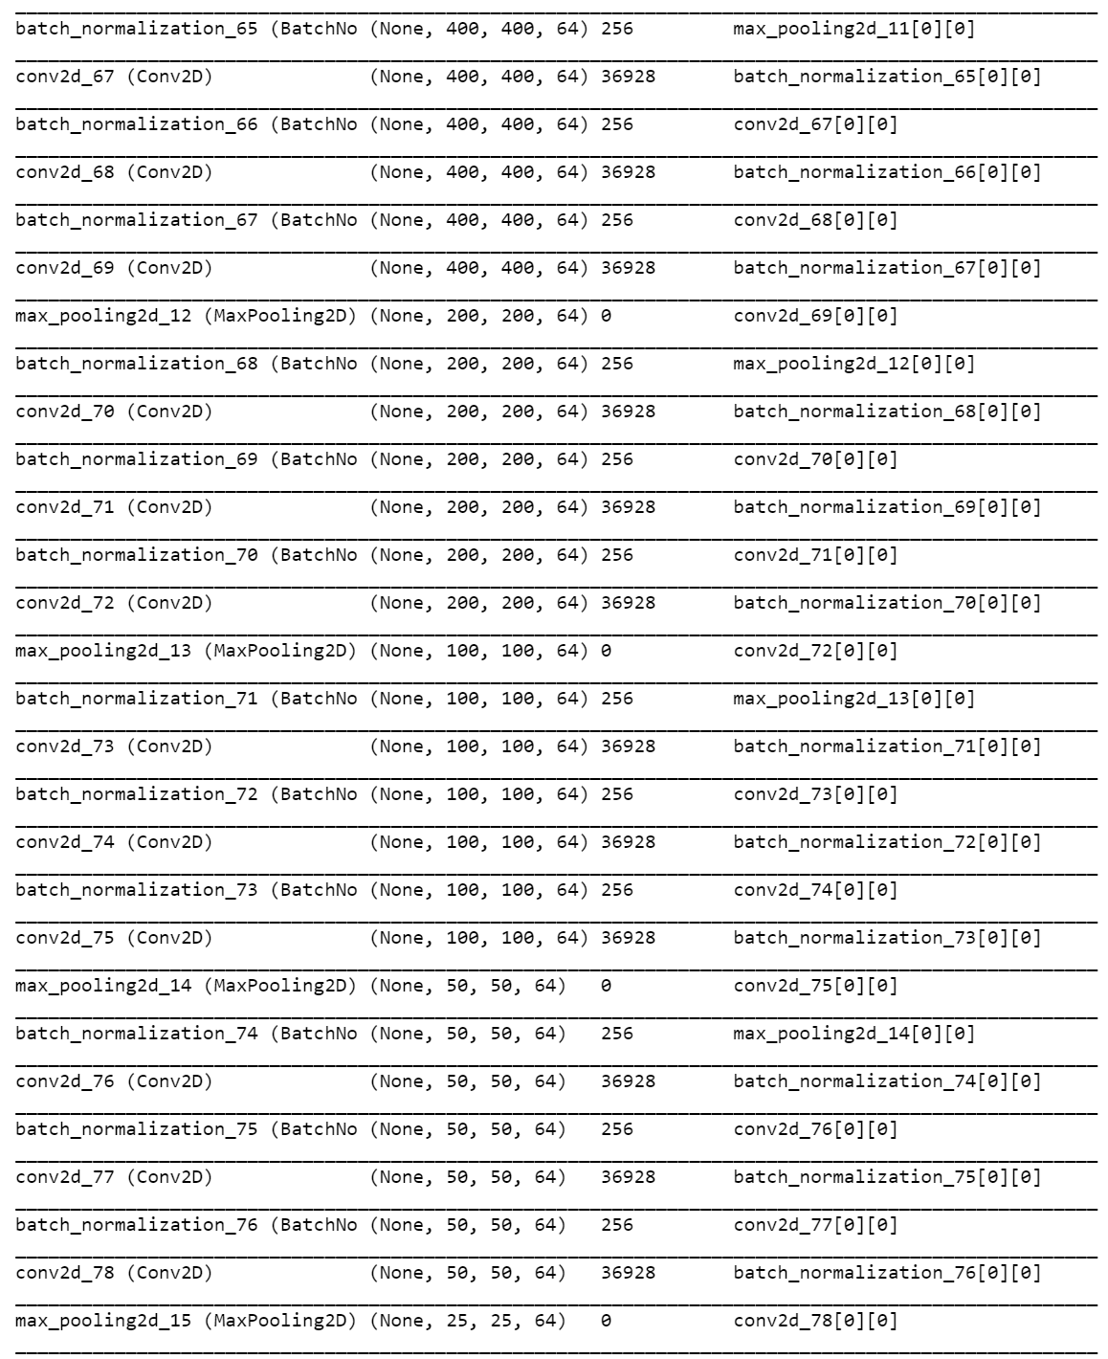
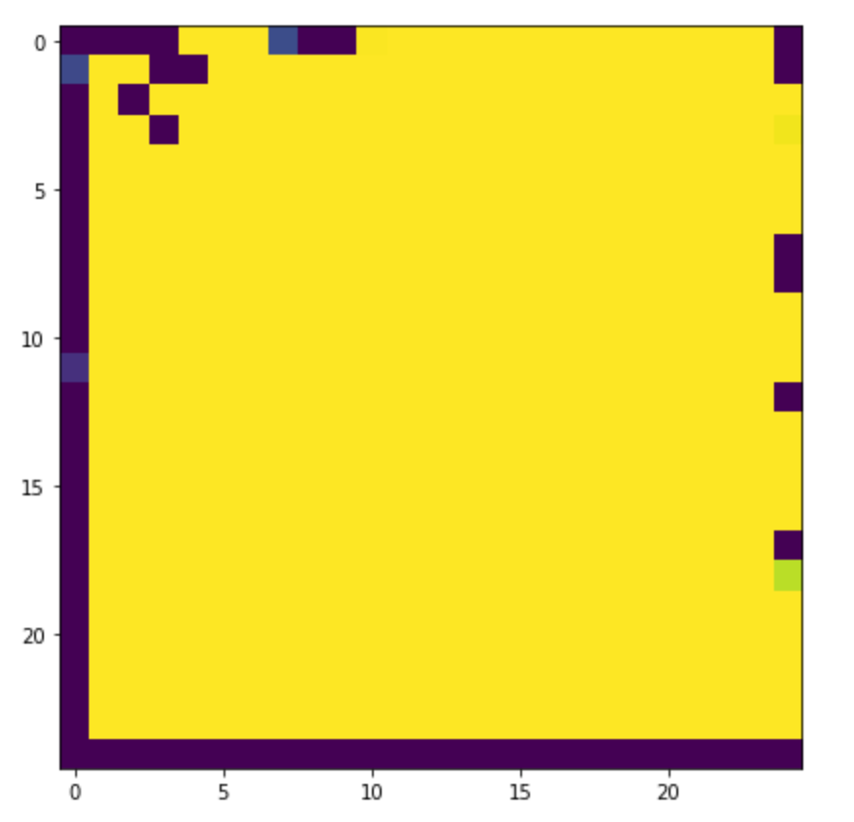
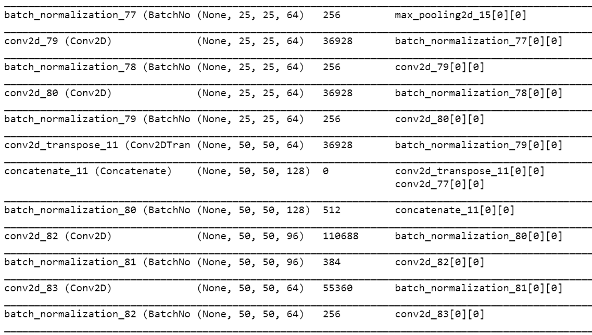
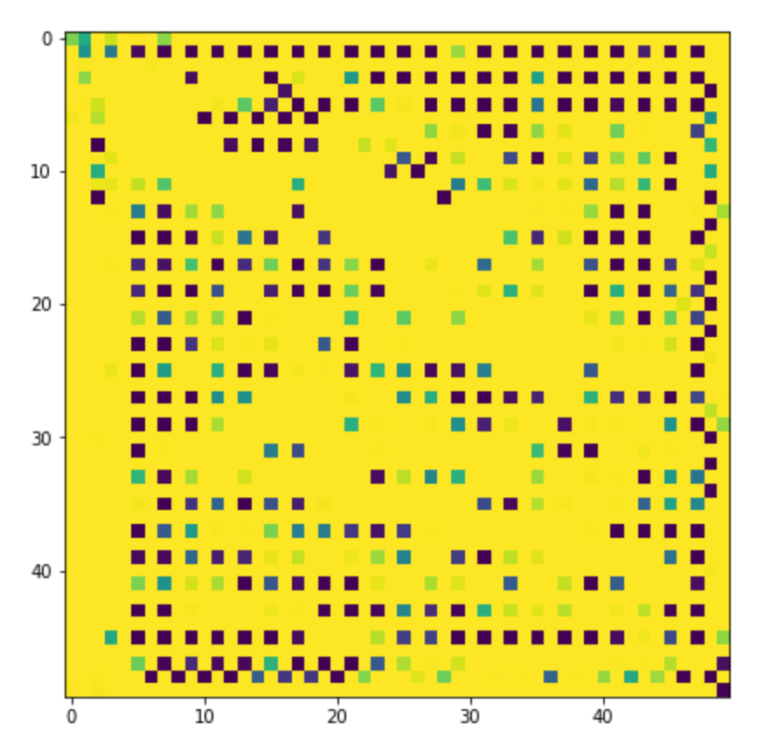
The architecture of Unet we build shows as following
First, we use 4 times down-sampling with 3*3 size kernel to get the high-level abstract feature map
Then we use up-sampling on the feature map to output map at equal size of input image.
The output of Unet model is a pixel-wise possibility For the purpose of accurately target localize.

Slide 18
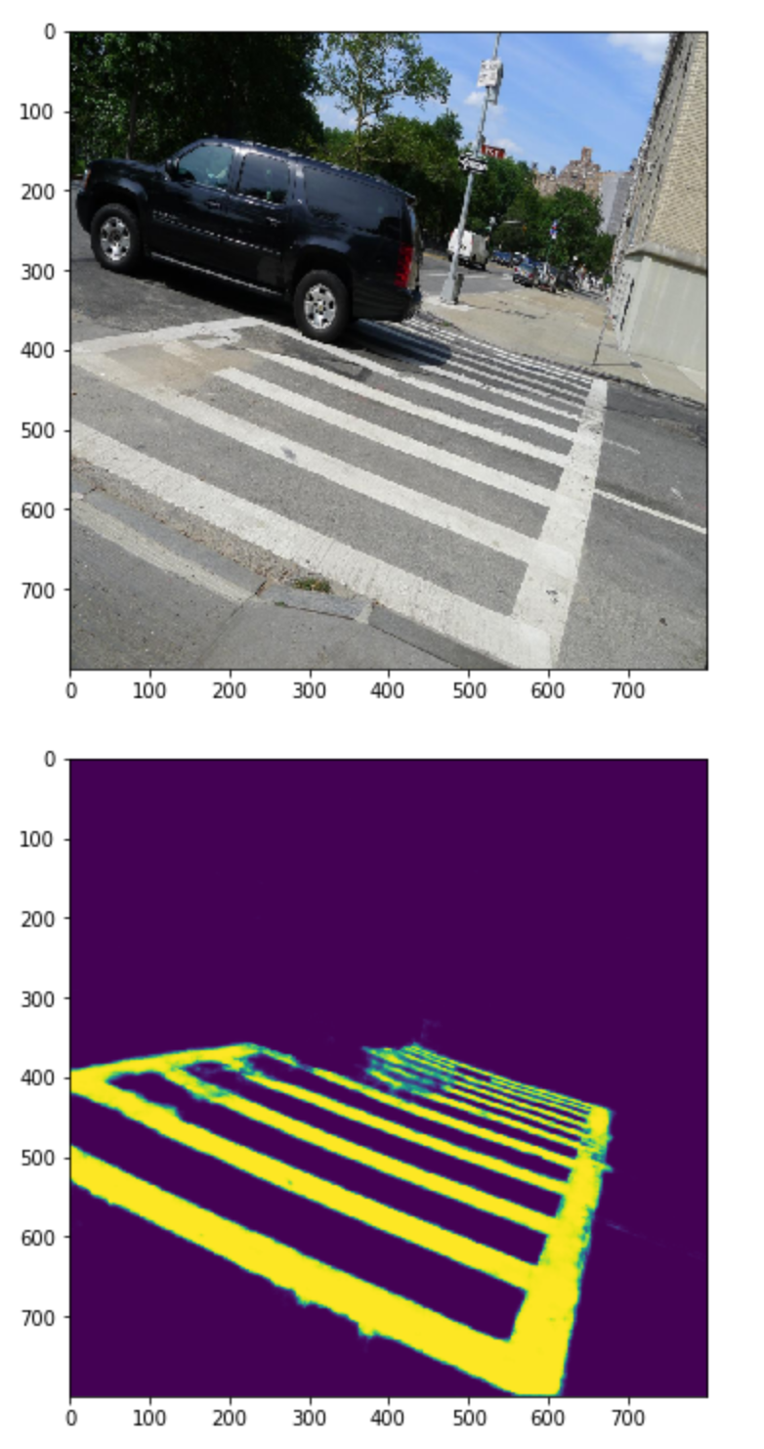
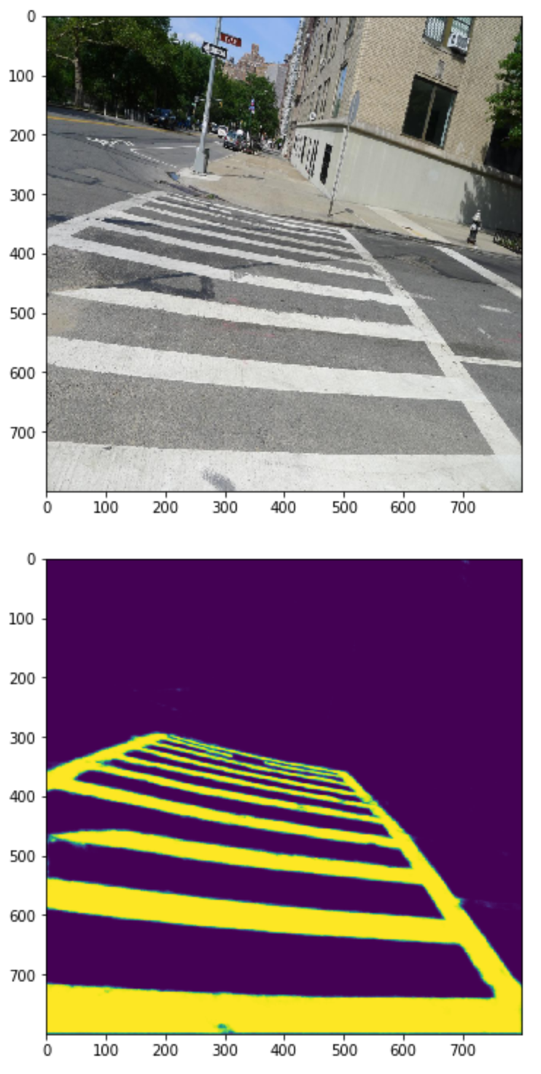
Segmentation result showing at left. The Unet can nicely mapping the position of crosswalk.
Finally, we evaluated on the best model and achieve mean IoU at 0.86302 by setting threshold equals to 0.5 and best F1-score at 0.89587.

Slide 19
After the semantic segmentation, we deploy Hough Transfer on the output image to detect the orientation and position of crosswalk.
The pipeline of Hough Transfer shows as following slide.
Because of the crosswalk images are One-point perspective, we can detect the orientation of zebra-crossing by calculating vanishing point.

Slide 20
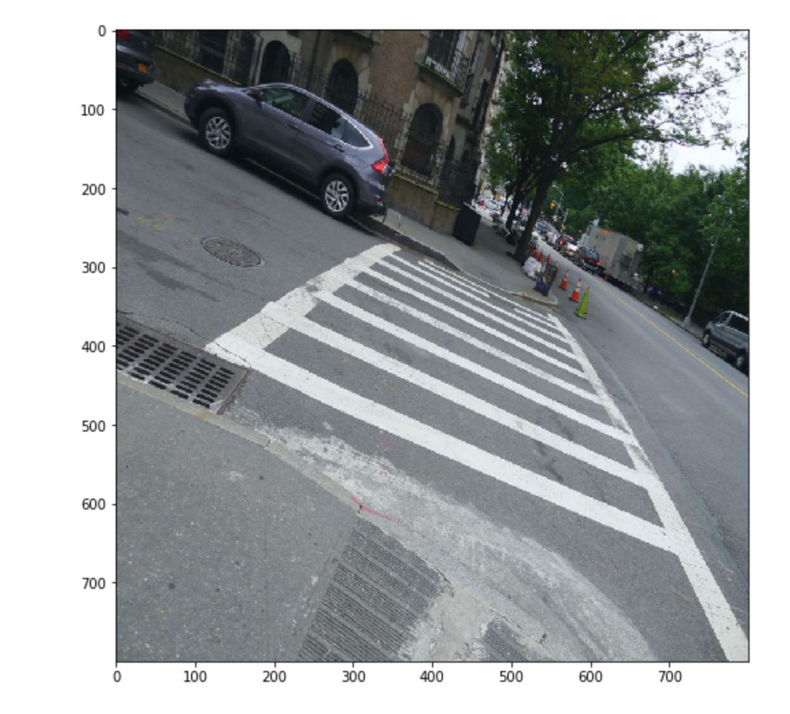
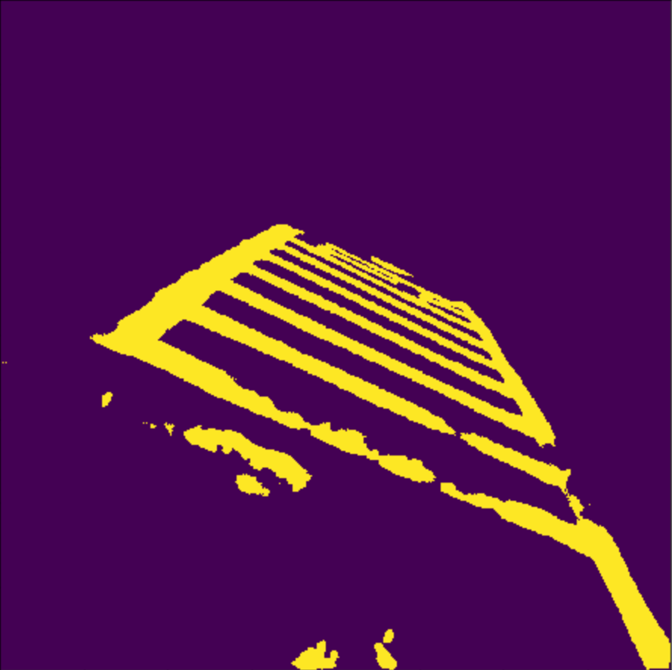
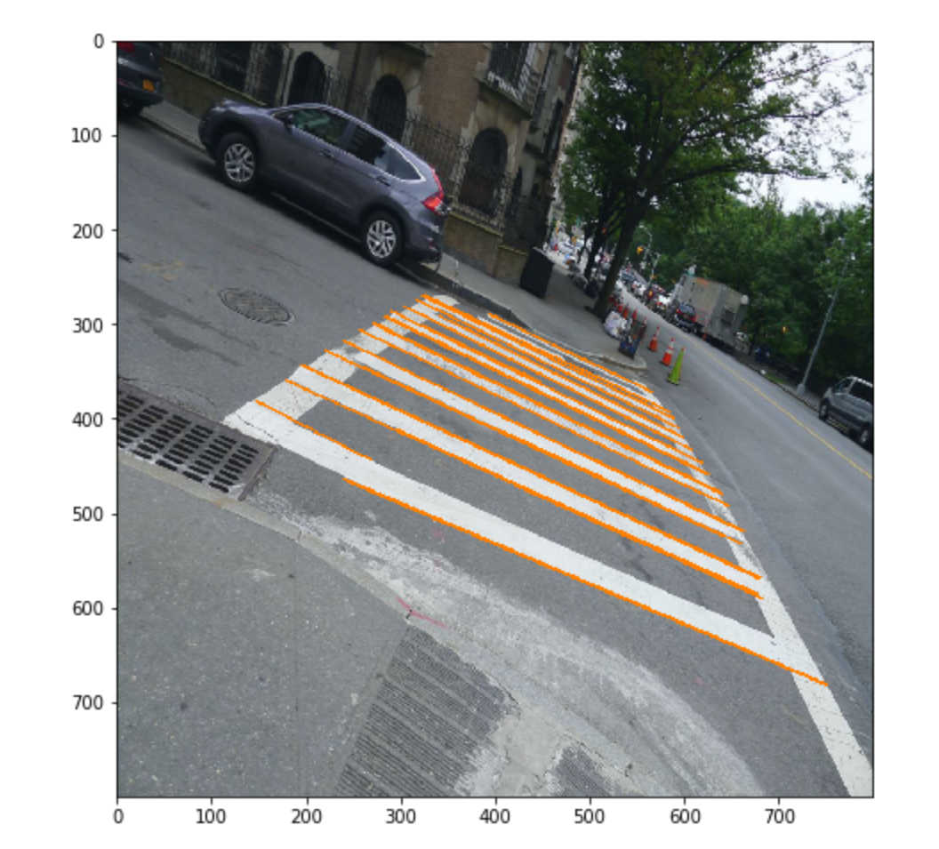
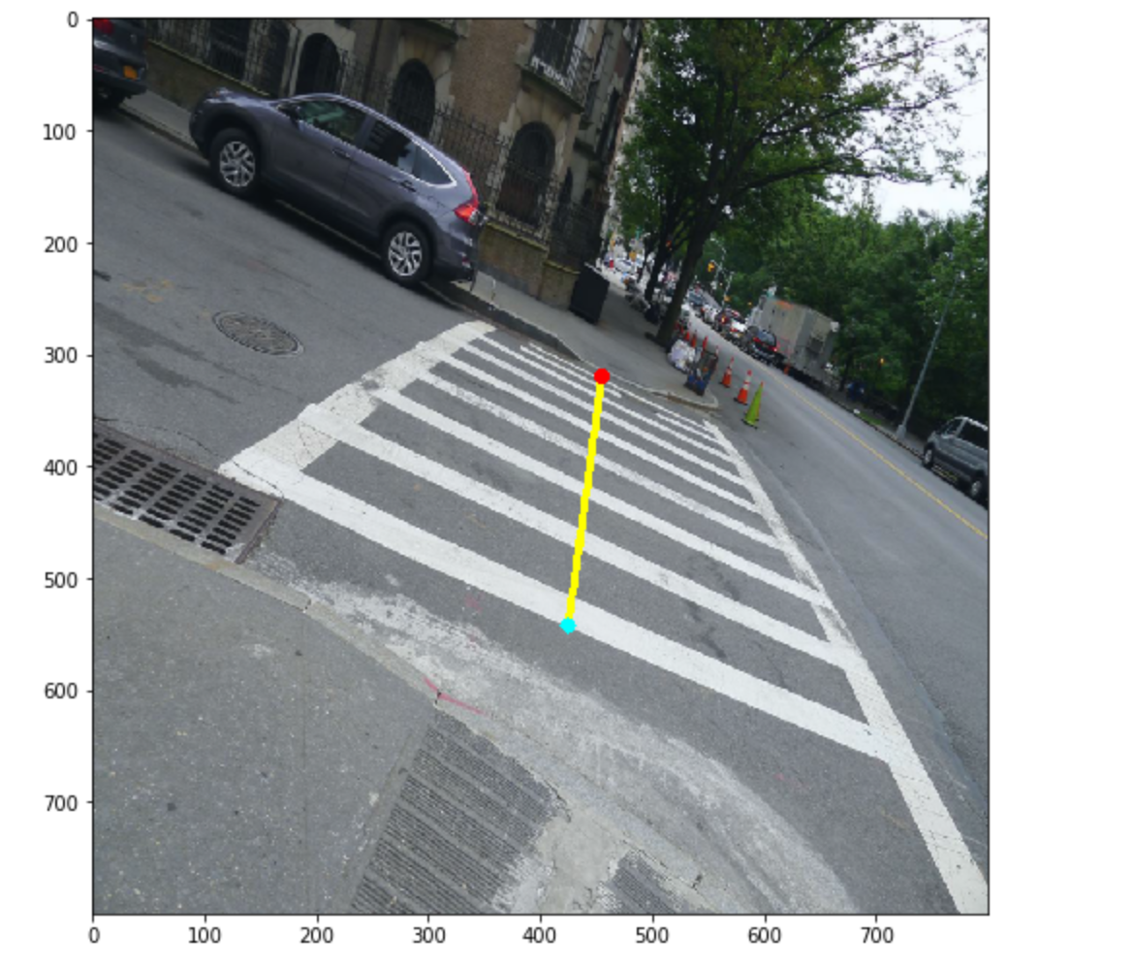
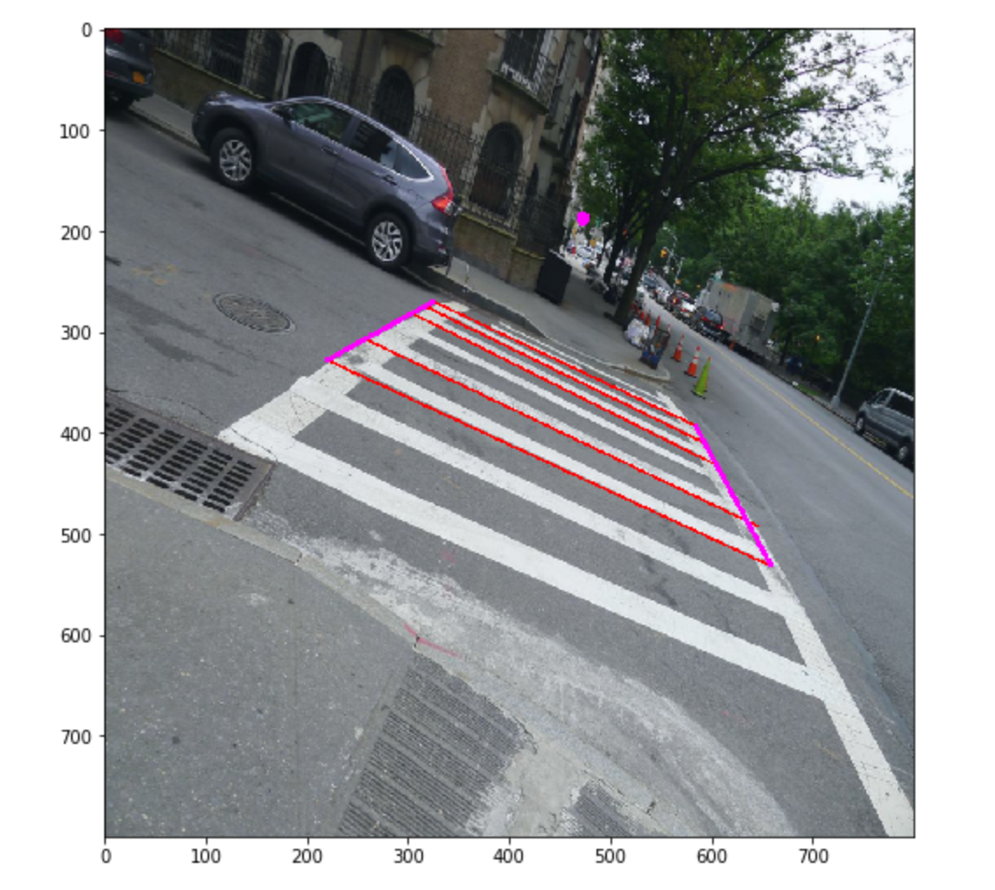
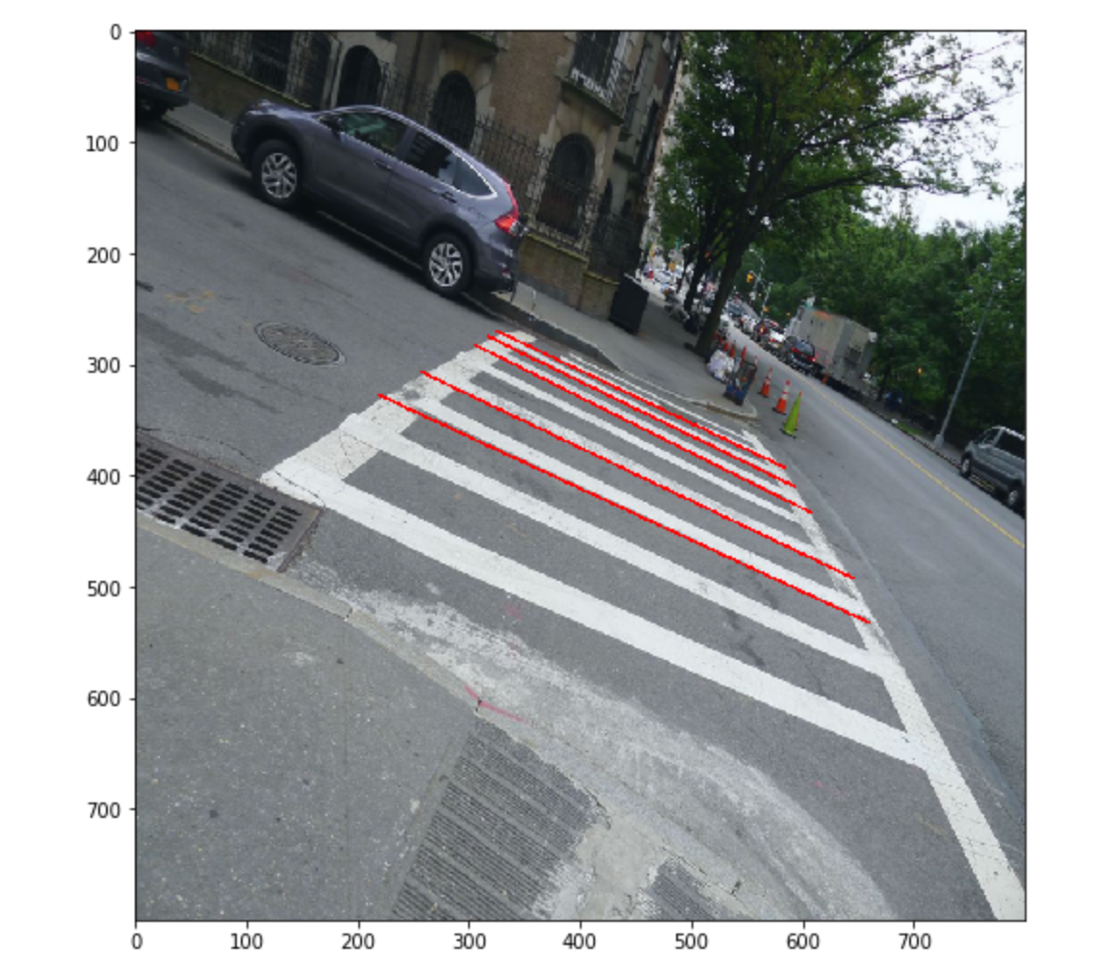

Slide 21
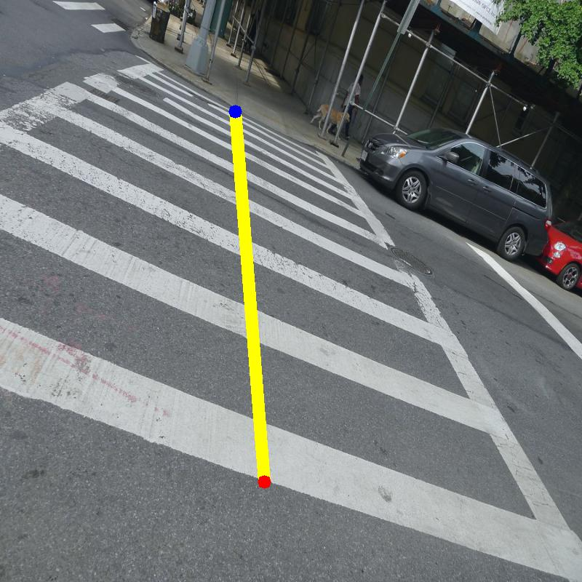
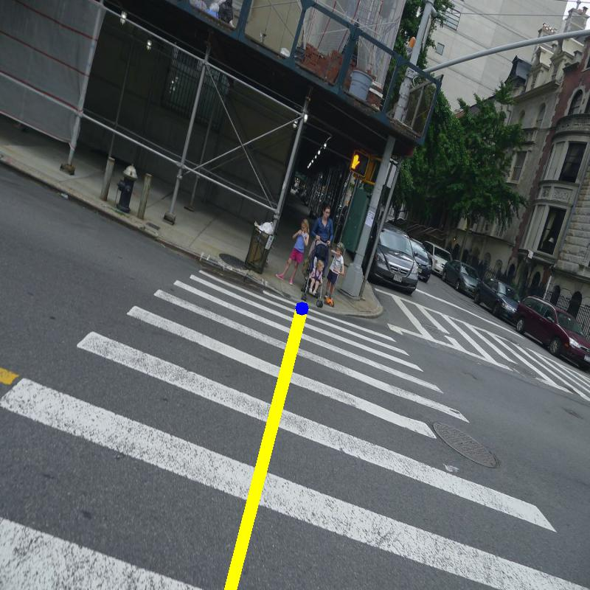
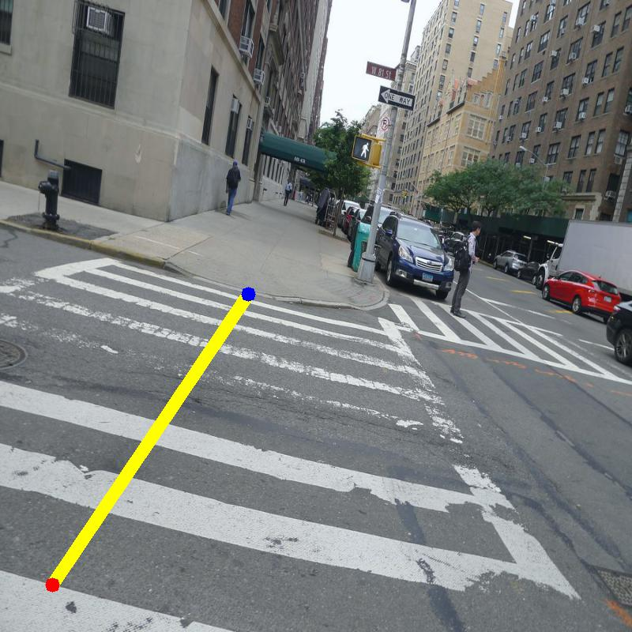
Output for crosswalk detection model

Slide 22
Future work
Next step we are thinking of deploying the detection model on video or stream. Using lighter network and wearable devices for hardware acceleration to guarantee high computing speed and accuracy.
We also considering create our own dataset and relabel the position and orientation of crosswalk

Slide 24
Thank you for your time

